Slide 1
Django
How to create login and registration in Django

Slide 2
Start a project
Create a project named login and then create an app named accounts
django-admin startproject login
cd login
python manage.py startapp accounts

Slide 3
Now, start the server using the command

Slide 4
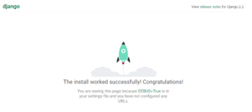

Slide 5
Migrate
Python manage.py migrate

Slide 6
Superuser is an admin account for your service. Being a superuser we can access and manipulate any data in the database. Usual users, by contrast, can manipulate only their own data.
To use an initialized console client, run python manage.py shell command.

Slide 7
python manage.py createsuperuser

Slide 8
Create your project according to the following tree:

Slide 9
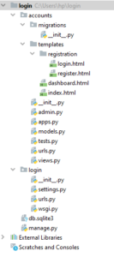

Slide 10
login\urls.py

Slide 11
Preparing URLs
urlpatterns =
[
path('admin/', admin.site.urls),
path('accounts/',include('accounts.urls')),
]

Slide 12
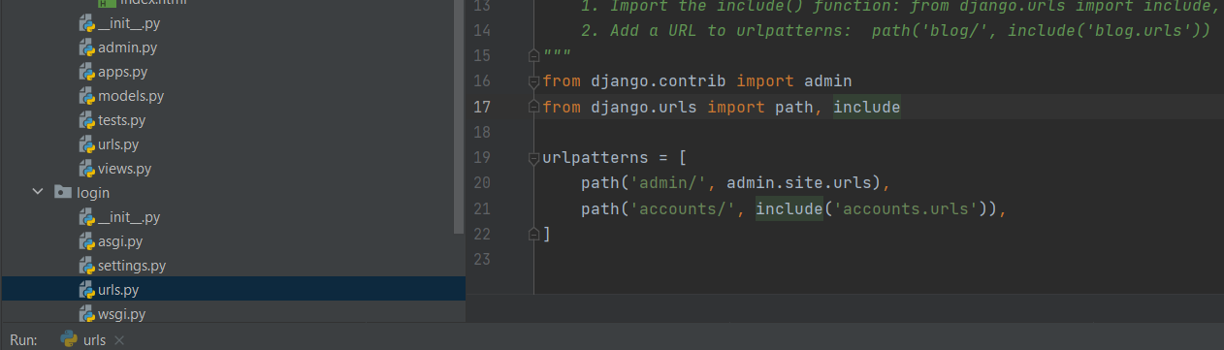

Slide 13
Also make changes in accounts\urls.py
from django.urls import path
from accounts import views
from django.contrib.auth.views import LoginView, LogoutView
urlpatterns = [
path(‘ ', views.indexView, name="home"),
path('dashboard/', views.dashboardView, name="dashboard"),
path('login/', LoginView.as_view(), name="login_url"),
path('register/', views.registerView, name="register_url"),
path('logout/', LogoutView.as_view(next_page='dashboard'), name="logout"),
]

Slide 14
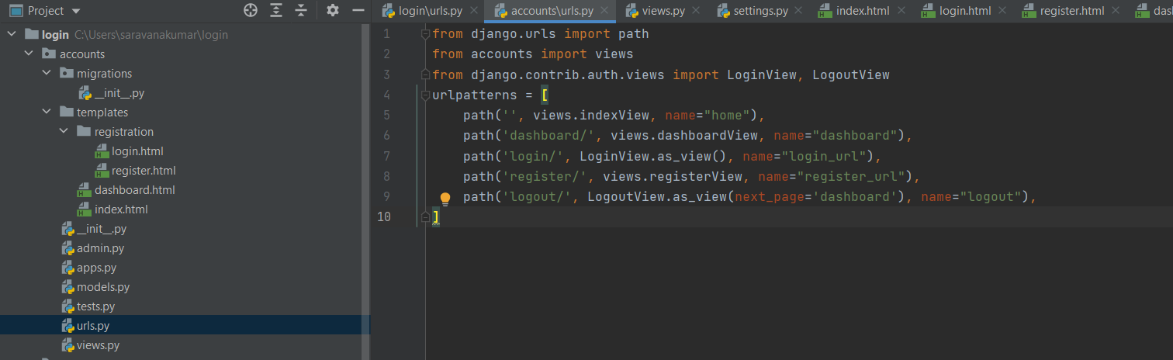

Slide 15
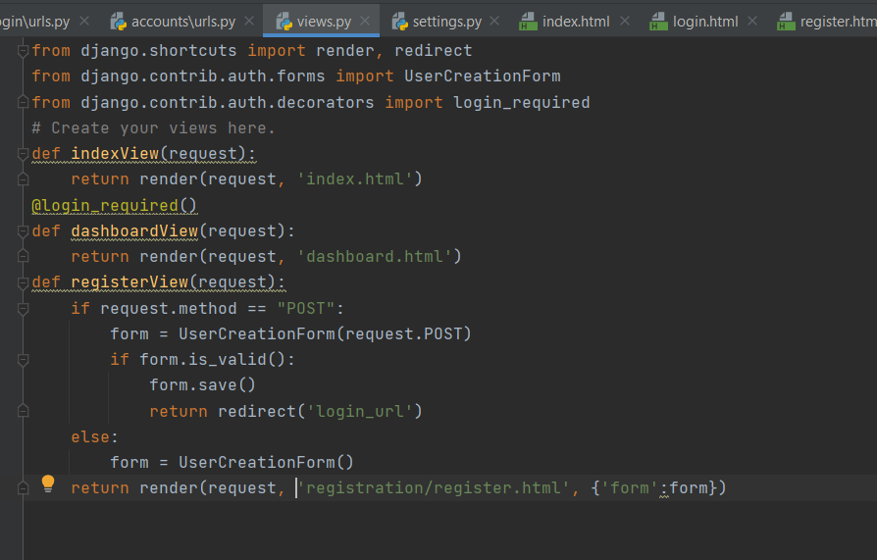
Views

Slide 16
Also make changes in your settings.py.
Do not forget to add ‘accounts’ app in the settings and also add the LOGIN_REDIRECT_URL at last as follows:

Slide 17
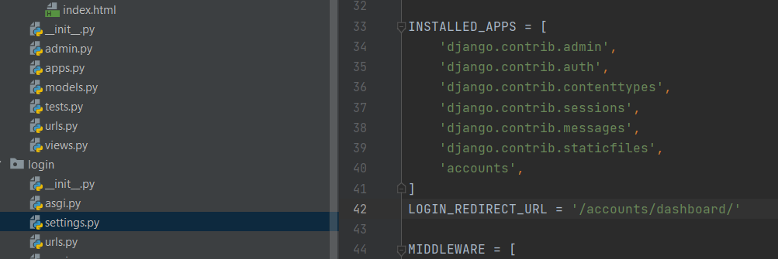

Slide 18
{% extends %}: this declares the template given as an argument as the current template's parent. Usage: {% extends 'parent_template.html' %}.
{% block %}{% endblock %}: This is used to define sections in your templates, so that if another template extends this one, it'll be able to replace whatever html code has been written inside of it. Blocks are identified by their name. Usage: {% block content %} <html_code> {% endblock %}.
{% include %}: this will insert a template within the current one. Be aware that the included template will receive the request's context, and you can give it custom variables too. Basic usage: {% include 'template_name.html' %}, usage with variables: {% include 'template_name.html' with variable='value' variable2=8 %}

Slide 19
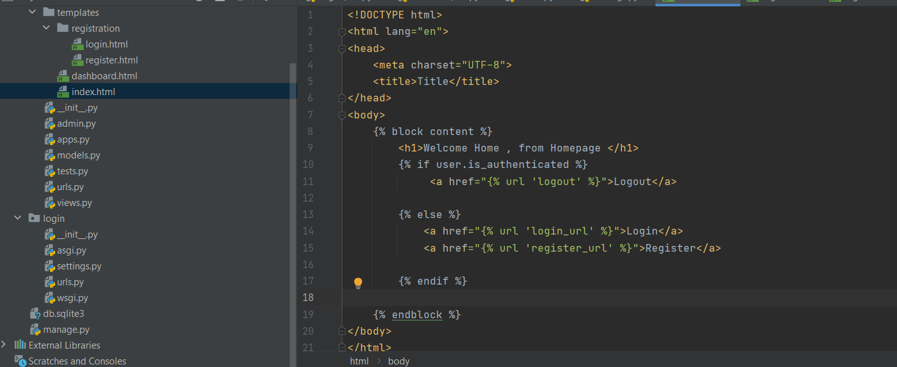
Index.html

Slide 20
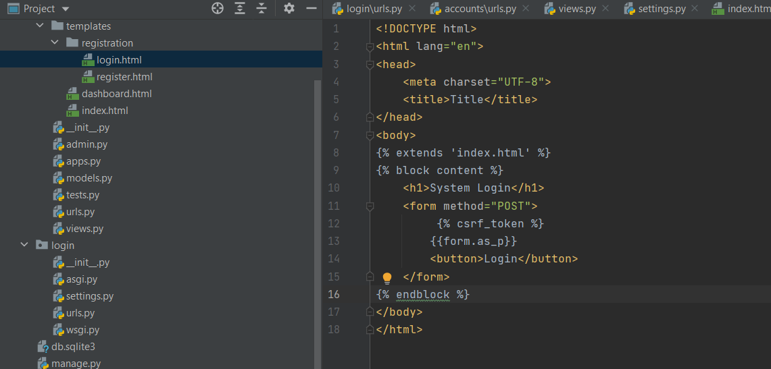
Login.html

Slide 21
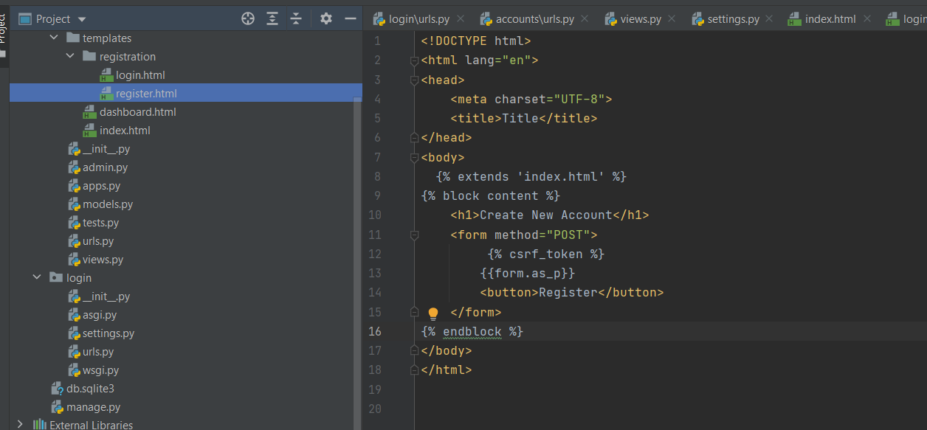
Define the register.html

Slide 22
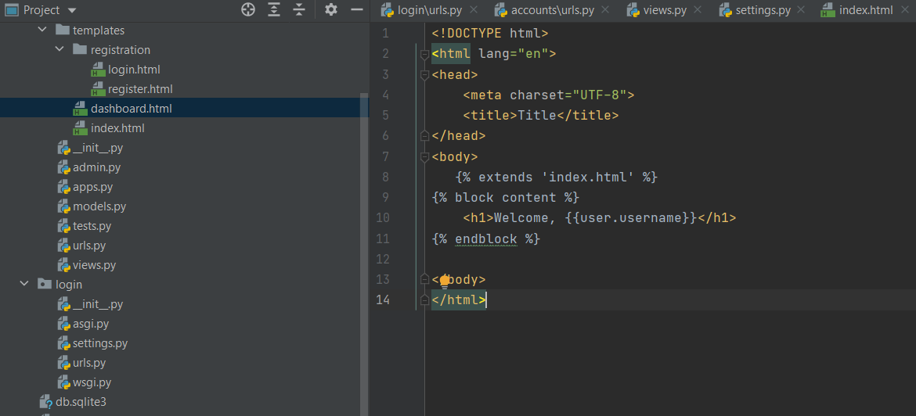
Define dashboard.html

Slide 23
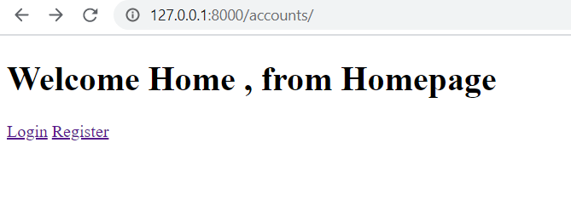

Slide 24
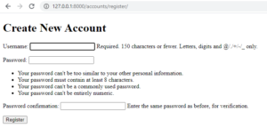
Accounts/register

Slide 25
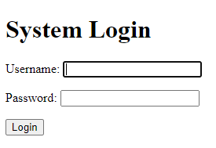
running the server/dashboard we will get the output like this:

